Slide 1
Unit-VI Architecture Design

Slide 2
Overview
Definition -Software Architecture is a structure of systems which consists of various components , externally visible properties of these components and interrelationship among these components.

Slide 3
Importance
1.Blueprint for system development
2.Represent earliest design decision
3.Define expected qualities of the system
4.Artifact for early analysis
5.Identify design risk.

Slide 4
Architectural View
1.Structural view
2.Dynamic view
3.Deployment view.

Slide 5
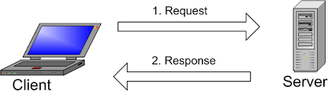
Designing Client/Server software architecture
Client/Server architecture patterns
1.Multiple clients single service/server
2.Multiple clients Multiple service/server
3.Multi tier client service

Slide 6
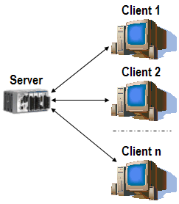
1.Multiple clients single service/server

Slide 7
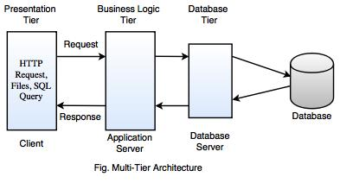

Slide 8
Service-Oriented Architecture
Service-Oriented Architecture (SOA) is an architectural approach in which applications make use of services available in the network.
There are two major roles within Service-oriented Architecture:
1.Service provider:
2.Service consumer:

Slide 9
Guiding Principles of SOA:
Standardized service contract: Specified through one or more service description documents. This makes it easier for client applications to understand what the service does, what the service is about
Loose coupling: Services are designed as self-contained components, maintain relationships that minimize dependencies on other services.
Abstraction: A service is completely defined by service contracts and description documents. They hide their logic, which is encapsulated within their implementation.
Reusability: Designed as components, services can be reused more effectively, thus reducing development time and the associated costs.
Autonomy: Services should have control over the logic they encapsulate. The service knows everything on what functionality it offers and hence should also have complete control over the code it contains.
Discoverability: Services are defined by description documents that constitute supplemental metadata through which they can be effectively discovered. Use
registry which can hold information about the web service.
Statelessness:-

Slide 10
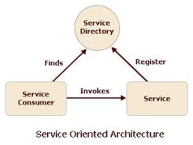

Slide 11
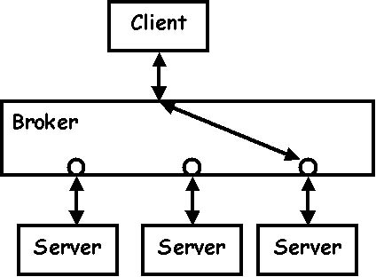
SOA-Broker pattern
-middleman between client and servers
-The client requests a specific service. It formats its request in a specific format and sends it to its broker. The broker then selects the most suitable server to process the request. When the link between the client and the server is set up, they may start communicating directly, freeing the broker.

Slide 12
Supports two types transparency
-Location
-Platform

Slide 13
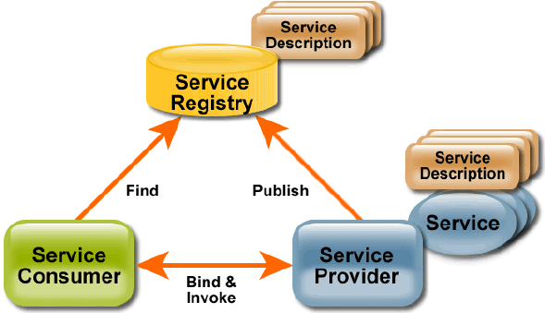

Slide 14
Components of Web Services
SOAP (Simple Object Access Protocol)
UDDI (Universal Description, Discovery and Integration)
WSDL (Web Services Description Language)

Slide 15
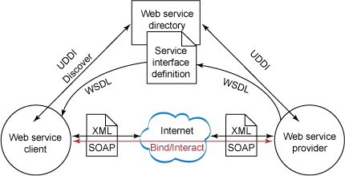

Slide 16
Component based software

Slide 17
Component diagram
A component is an encapsulated, reusable, and replaceable part of your software
Reducing and defying coupling between software components
Reusing existing components

Slide 18
Model physical software components and the interfaces between them
Show the structure of the code itself
Can be used to hide the specification detail (i.e., information hiding) and focus on the relationship between components
Model the structure of software releases; show how components integrate with current system design

Slide 19
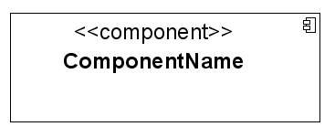
A Component is a physical piece of a system, such as a compiled object , piece of source code, shared library or Enterprise Java Bean (EJB).

Slide 20
Views of components
1.Black Box: shows how the components looks from outside including interfaces and how it relates to other components.
2.White Box: shows inter details of components.

Slide 21
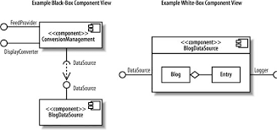

Slide 22


INTERFACE-Assembaly connector
A provided interface
Characterize services that the component offers to its environment
Is modeled using a ball, labelled with the name, attached by a solid line to the component
A required interface
Characterize services that the component expects from its environment
Is modeled using a socket, labelled with the name, attached by a solid line to the component
In UML 1.x were modeled using a dashed arrow

Slide 23
A provided interface of a component is an interface that the component Realizes
A required interface of a component is an interface that the component needs to function

Slide 24
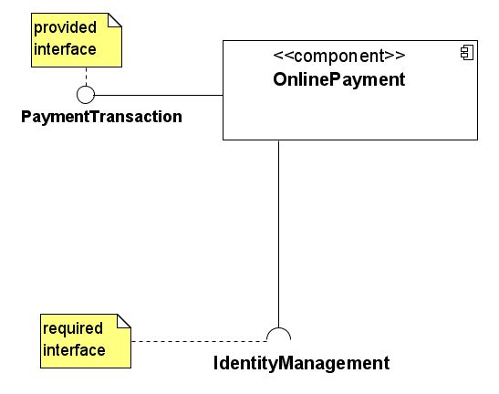
Component Interfaces

Slide 25
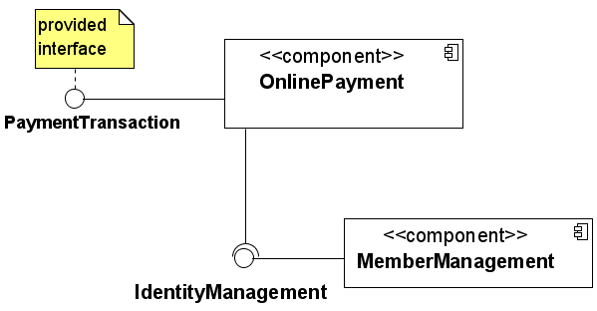
Components can be \wired together to form subsystems

Slide 26

Ports
A port indicates that the component itself does not provide the required interfaces (e.g., required or provided). Instead, the component delegates
the interface(s) to an internal class.

Slide 28

Component dependencies

Slide 29
